Slide 1
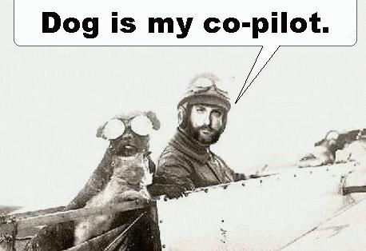
Dyslexia

Slide 2
Dyslexia
Two routes to understanding dyslexia:
  Orthographic
  Phonemic
☺

Slide 3
Properties of Dyslexia
Unexpected difficulty in reading
Affects 5-17.5% of population
Affects children & adults
Equally affects men & women

Slide 4
Properties of Dyslexia
IQ, motivation, schooling are all in normal range
80% of learning disabled are also dyslexic
Heritable
  One sibling→40% chance other sibs will
  Parent→23-65% chance children will

Slide 5
Signs of Dyslexia
Trouble playing rhyming games
Confusing words that sound the same
Mispronunciations
Hesitations/trouble finding words

Slide 6
Theories of Dyslexia
Perceptual problem
Phonological Deficit problem
Dual route model

Slide 7
Dyslexia as a Perceptual Problem
Orton (1925)
Dyslexia resulted from perceptual difficulties:
  b/p, b/d, saw/was

Slide 8
Dyslexia as a Perceptual Problem
Yet dyslexics don’t perform differently on visual perception tasks:
In short, dyslexia is not (primarily) a perceptual problem

Slide 9
Dyslexia as a perceptual problem
Posner task:
  Physical match: AA
  Name match: Aa
  Mismatch: AB, Ab, etc.
Dyslexics as good as controls on physical but not name match

Slide 10
Phonological Deficit Hypothesis
Dyslexia results from the inability to segment words (written or spoken) into phonemes or component sounds
OR
Deficits in phonemic awareness

Slide 11
Dual Route Model
Lexical: Access to pronunciation of whole words
  Primarily for exception words (mint) & well-learned words
Orthographic!

Slide 12
Dual Route Model
Grapheme-Phoneme Correspondence: Ability to know which sounds the letters on the page make
  Primarily for new words & nonwords
Phonemic

Slide 13
Types of Dyslexia
Surface: Breakdown in the lexical route
  Less common (~16%)
Phonological: Breakdown in the GPC route
  More common (~84%)

Slide 14
Interventions: Children
Systematic & highly structured instruction of code based reading strategies
Physical production patterns for phoneme production (how you make the sound)
Reading in context

Slide 15
Interventions: Adults
Extra time
Use of spell checkers & tape recorders
Tutors

